Slide 1

Advanced Topics in Economic Evaluation and Healthcare
Lecture #9: Budget Impact Analysis

Slide 2
Lecture Overview
In this lecture we will discuss budget impact analysis. In particular we will discuss:
  What budget impact analysis is.
  Static Models of Budget Impact Analysis (A Cost Calculator Approach)
  Implied Budget Impact Analysis from Cost Effectiveness Analysis.
  A Brief Overview of Line Models and the problem of sequencing.

Slide 3
Motivation
Not All Cost-Effective Treatments Get Approved

Slide 4


Slide 5
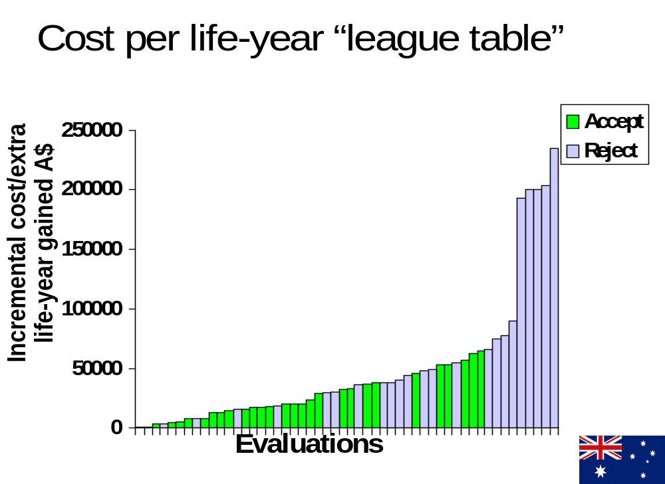

Slide 6
Under a hard Threshold
Everything Below this Line
should be accepted!
What is going on here?

Slide 7
An Introduction to Budget Impact Analysis

Slide 8
What is Budget Impact Analysis
Most policy instruments are not numeric like taxes or interest rate. Rather they are questions of whether governments, insurance policies or other third parties will pay for something.
Budget impact analysis can be thought of as thinking about what would happen if you leant someone your credit card. (how big will the bill be?)
The policy variables in working health economic questions are “what would happen if we decide to add this drug to the list of treatments that we (the government, insurance company or other third party) will pay for”.
We can think of this analogously as how adding a new item to a menu of things that you are willing to pay for.

Slide 9
Why Budget Impact Analysis is Important.
Suppose we have a list of possible treatments to fund with their computed ICER, cost per patient and the size of the patient population.
Cost effectiveness analysis on its own tells us to fund the treatments that are at or below a particular threshold.
However, this rule on its own does not tell us if funding a treatment is feasible.
Budget Impact Analysis tells us if the funding of a treatment is feasible for a particular decision maker.
Treatment | Unit Cost (per patient) | ICER (Cost per QALY gained) | Patient Type | Patient Population Size
Treatment A | $12,000 | $45,000/QALY | Adults with moderate rheumatoid arthritis | 150,000 patients
Treatment B | $8,500 | $35,000/QALY | Patients with stage II hypertension | 2,100,000 patients
Treatment C | $25,000 | $95,000/QALY | Individuals with metastatic melanoma | 70,000 patient
THE ICER IS IMPORTANT, BUT FEASIBILITY IS AS, IF NOT MORE, IMPORTANT.

Slide 10
Budget Impact Analysis VS Cost Effectiveness Analysis
CEA
Used to determine the value for money associated with a treatment.
Key Statistics Computed:
BIA
Used to determine the Feasibility of funding a particular treatment.
Key Statistics Computed:
Tells us if we are getting a “good deal” by funding a treatment
Tells us if paying for a treatment is affordable.
Computed Statistic is useful and generalizable to many different Environments
Estimates are often useful to the studied budget holder. Model structure can be generalized but not estimates.
Expected Budget Impact.
Scenario Analysis for High and Low Uptake Cases.
ICER
Probability of Cost Effectiveness

Slide 11
Comments about Budget Impact Analysis
Budget impact analysis is for the most part highly stylized, usually implemented in spreadsheets and atheoretical.
The methods used in budget impact analysis will be one informed by considering changes in treatment mixes on a specific target population.
I think its particularly important as this provides a insight on the tools working health economists use regularly.

Slide 12
Static Models of Budget Impact Analysis

Slide 13
What is Budget Impact Analysis
Most policy instruments are not numeric like taxes or interest rate. Rather they are questions of whether governments, insurance policies or other third parties will pay for something.
Budget impact analysis can be thought of as thinking about what would happen if you leant someone your credit card. (how big will the bill be?)
The policy variables in working health economic questions are “what would happen if we decide to add this drug to the list of treatments that we (the government, insurance company or other third party) will pay for”.
We can think of this analogously as how adding a new item to a menu of things that you are willing to pay for.

Slide 14

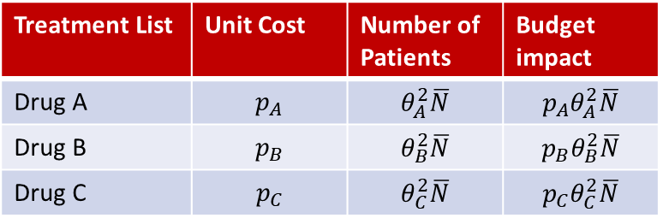
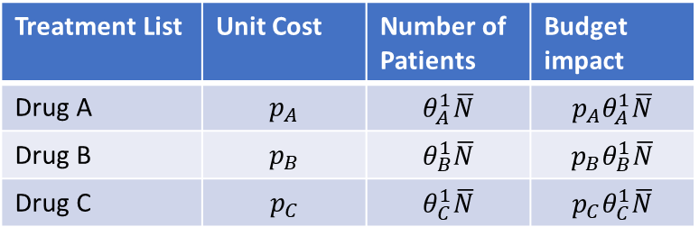
A Static Model of Budget Impact Analysis
The method below is referred to a the “cost calculator approach”
Define a menu of treatment plans or drugs used to treat the ailment we are interested in and two scenarios
Treatment List | Unit Cost | Number of Patients | Budget impact
Drug A | $$p_{A}$$ | $$θ_{A}^{1}\overline{N}$$ | $$p_{A}θ_{A}^{1}\overline{N}$$
Drug B | $$p_{B}$$ | $$θ_{B}^{1}\overline{N}$$ | $$p_{B}θ_{B}^{1}\overline{N}$$
Drug C | $$p_{C}$$ | $$θ_{C}^{1}\overline{N}$$ | $$p_{C}θ_{C}^{1}\overline{N}$$
$$θ_{A}^{i}+θ_{B}^{i}+θ_{C}^{i}=1$$
Scenario A
Treatment List | Unit Cost | Number of Patients | Budget impact
Drug A | $$p_{A}$$ | $$θ_{A}^{2}\overline{N}$$ | $$p_{A}θ_{A}^{2}\overline{N}$$
Drug B | $$p_{B}$$ | $$θ_{B}^{2}\overline{N}$$ | $$p_{B}θ_{B}^{2}\overline{N}$$
Drug C | $$p_{C}$$ | $$θ_{C}^{2}\overline{N}$$ | $$p_{C}θ_{C}^{2}\overline{N}$$
Scenario B

Slide 15

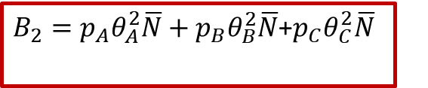
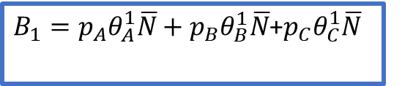
A Static Model of Budget Impact Analysis
The method below is referred to a the “cost calculator approach”
Define a menu of treatment plans or drugs used to treat the ailment we are interested in.
Treatment List | Unit Cost | Number of Patients | Budget impact
Drug A | $$p_{A}$$ | $$θ_{A}^{1}\overline{N}$$ | $$p_{A}θ_{A}^{1}\overline{N}$$
Drug B | $$p_{B}$$ | $$θ_{B}^{1}\overline{N}$$ | $$p_{B}θ_{B}^{1}\overline{N}$$
Drug C | $$p_{C}$$ | $$θ_{C}^{1}\overline{N}$$ | $$p_{C}θ_{C}^{1}\overline{N}$$
$B_{1}=p_{A}θ_{A}^{1}\overline{N}+p_{B}θ_{B}^{1}\overline{N}$+$p_{C}θ_{C}^{1}\overline{N}$
Scenario A
Incremental Budget Impact
$$ΔB=B_{2}−B_{1}$$
Treatment List | Unit Cost | Number of Patients | Budget impact
Drug A | $$p_{A}$$ | $$θ_{A}^{2}\overline{N}$$ | $$p_{A}θ_{A}^{2}\overline{N}$$
Drug B | $$p_{B}$$ | $$θ_{B}^{2}\overline{N}$$ | $$p_{B}θ_{B}^{2}\overline{N}$$
Drug C | $$p_{C}$$ | $$θ_{C}^{2}\overline{N}$$ | $$p_{C}θ_{C}^{2}\overline{N}$$
Scenario B
$B_{2}=p_{A}θ_{A}^{2}\overline{N}+p_{B}θ_{B}^{2}\overline{N}$+$p_{C}θ_{C}^{2}\overline{N}$

Slide 16
Conducting Budget Impact Analysis
Budget impact analysis considers two scenarios.
-A scenario where a treatment is available among current treatments.
-A scenario where the treatment is not available among current treatments.
We care about how the inclusion of a treatment will impact spending for a particular condition or set of conditions.
ALL BUDGET IMPACT ANALYSIS IS AN ANALYSIS OF A CHANGE IN SPENDING DUE TO INTRODUCTION OF A NEW TREATMENT.

Slide 17
Scenario Analysis In Budget Impact Analysis
Drug | Patients | Costs Per Unit | Market Share
Surgical Procedure | 3,200 patients | $9000 | 0.6
Advanced Biologic | 1,100 patients | $20,000 | 0.3
Gene Therapy | 150 patients | $65,000 | 0.1
To conduct a scenario analysis, we are interested in how the Budget Impact Changes when a New Treatment is Introduced.
Scenario A
Drug | Patients | Costs Per Unit | Market Share
Surgical Procedure | 3,200 patients | $9000 | 0.7
Advanced Biologic | 1,100 patients | $20,000 | 0.3
Gene Therapy | 150 patients | $65,000 | 0
Scenario B

Slide 18
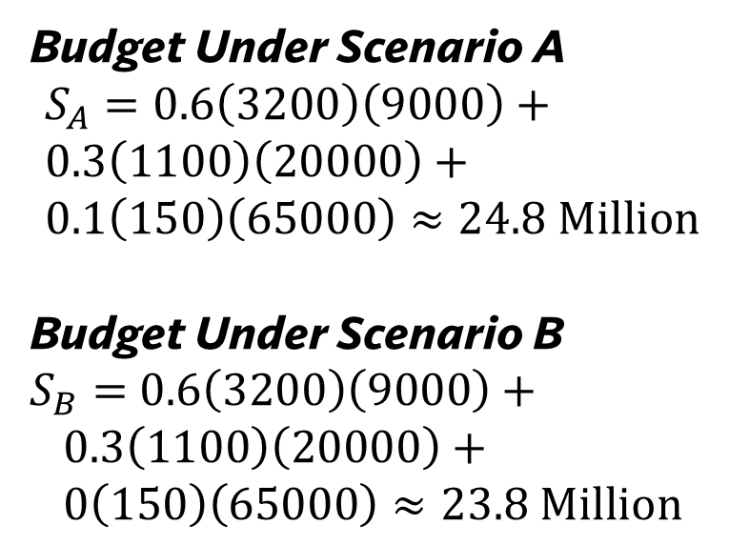
Scenario Analysis In Budget Impact Analysis
Drug | Patients | Costs Per Unit | Market Share
Surgical Procedure | 3,200 patients | $9000 | 0.6
Advanced Biologic | 1,100 patients | $20,000 | 0.3
Gene Therapy | 150 patients | $65,000 | 0.1
Budget Under Scenario A
$S_{A}=0.6\left(3200\right)\left(9000\right)+$
$0.3\left(1100\right)\left(20000\right)+$
$0.1\left(150\right)\left(65000\right)≈24.8 Million$
Budget Under Scenario B
$S_{B}=$ $0.6\left(3200\right)\left(9000\right)+$
$0.3\left(1100\right)\left(20000\right)+$
$0\left(150\right)\left(65000\right)≈23.8 Million$
Scenario A
Drug | Patients | Costs Per Unit | Market Share
Surgical Procedure | 3,200 patients | $9000 | 0.7
Advanced Biologic | 1,100 patients | $20,000 | 0.3
Gene Therapy | 150 patients | $65,000 | 0
Scenario B

Slide 19
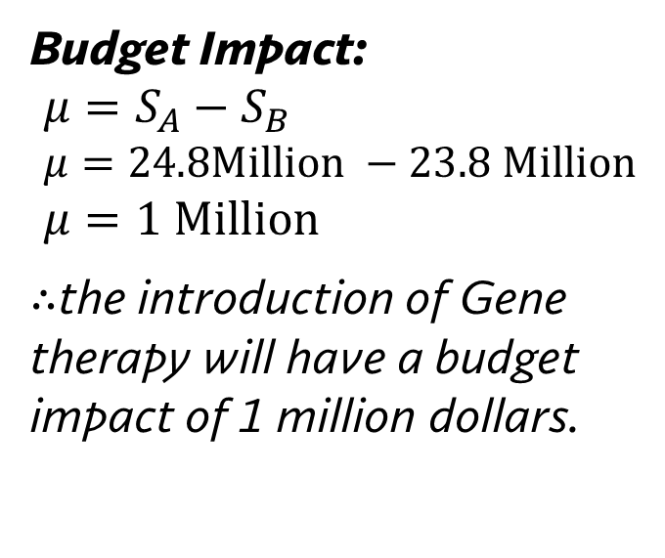
Scenario Analysis In Budget Impact Analysis
Drug | Patients | Costs Per Unit | Market Share
Surgical Procedure | 3,200 patients | $9000 | 0.6
Advanced Biologic | 1,100 patients | $20,000 | 0.3
Gene Therapy | 150 patients | $65,000 | 0.1
Budget Impact:
$μ=S_{A}−S_{B}$
$μ=24.8Million −23.8 Million$
$μ=1 Million$
$∴$the introduction of Gene therapy will have a budget impact of 1 million dollars.
Scenario A
Drug | Patients | Costs Per Unit | Market Share
Surgical Procedure | 3,200 patients | $9000 | 0.7
Advanced Biologic | 1,100 patients | $20,000 | 0.3
Gene Therapy | 150 patients | $65,000 | 0
Scenario B

Slide 20
Budget Impact Analysis “Implied” from Cost Effectiveness Analysis

Slide 21
Cost Effectiveness Analysis VS Budget Impact Analysis
There are two analytical steps a new treatment must pass in order for it to be added to a menu of treatments a third party would pay for.
This being cost effectiveness analysis and the next is budget impact analysis.
We note that the methods of cost effectiveness analysis are quite theoretically sound both in terms of economic theory and clinical relevance, however budget impact analysis is not.
This is because the way we have discussed the models of budget impact analysis thus far are based on external choice of uptake rates and substitution patterns between drugs rather than being informed by a both economically and medically sound framework.
We ask: What do we need to do in order to use our cost effectiveness models such as decision trees and markov models as working models of budget impact analysis?

Slide 22
How to theoretically ground Budget Impact Analysis
There is a presentation by Mike Paulden from the University of Alberta titled “Cost-effectiveness analysis and budget impact assessment: Combining the two for the aid of decision makers” which does exactly this. (link to presentation in description).
The way this is done is through a transformation of our CE plane. And noting that budget impact is simply just a “total change in costs”.
Even though there is currently no working paper at this time, this type of thinking “microfounds” budget impact analysis in the decision making of clinicians as they look at the clinical pathway as embodied by decision tree or Markov models.

Slide 23

Paulden’s Approach
$$ΔC$$
$$λ$$
$$ΔE$$

Slide 24

$$λ$$
Paulden’s Approach
$$ΔC×N$$
$$ΔE×N$$

Slide 25
Paulden’s Approach
$$λ$$
$$ΔC×N$$
Our solution concept does not change.
This is because:
$$λ=\frac{ΔC×N }{ΔE×N}=\frac{ΔC}{ΔE}$$
$$ΔE×N$$

Slide 26
What we can do with Paulden’s Approach
$$ΔC×N$$
$$ΔC×N$$
$$ΔE×N$$
$$ΔE×N$$

Slide 27
What we can do with Paulden’s Approach
$$ΔC×N$$
$$ΔC×N$$
$$ΔE×N$$
$$ΔE×N$$

Slide 28
What we can do with Paulden’s Approach
$$ΔC×N$$
$$ΔC×N$$
Using the distribution of $ΔC×N$ the average budget Impact we see is $μ_{B}$ with a variance $σ_{B}^{2}$
$$ΔE×N$$
$$ΔE×N$$

Slide 29
Line Models and Sequencing

Slide 30
The Sequencing Problem
There are over 10 different targeted drugs used for treating ulcerative colitis with dozens of different variants.
Treatments will not work for everyone.
The question we ask: what is the optimal sequence of drugs to try?
With 10 alone, there are over 10!=3,628,800 different possible drug sequences!
While diagnostics help, more often than not step therapy or “Fail First” Therapy is used. This is often a constraint required by insurance where lower cost treatments are used before more costly ones.

Slide 31
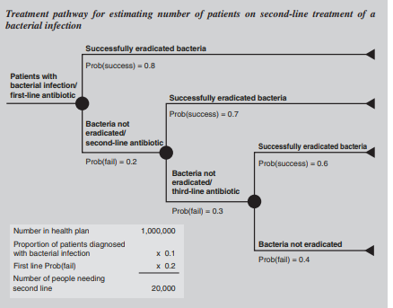
Sequencing Treatments an Example
The sequencing of treatments is not trivial.
In a case where we know 3 costs will be incurred over three periods the cheapest should be incurred first followed by the more expensive.
This is argument is based on discounting (more expensive treatments are cheaper if the cost is incurred later).
THIS RULE OFTEN FAILS WHEN WE ACCOUNT FOR THE EFFICACY OF A TREATMENT (i.e. The cheapest option, which is least effective may not be the the best treatment to put first if we wish to minimize budget impact).
THERE IS NO SIMPLE ANSWER TO THIS QUESTION.
From “Budget Impact Analysis of healthcare interventions” by Mauskopf et al

Slide 32

Concluding Remarks on Budget Impact Analysis
Budget Impact Analysis is not Rocket Science.
Budget Impact Analysis can Be as Simple or as Complex as You Like.
  Simple?- Scenario Analysis
  Complex?- Analyze a whole sequence of treatments
We will see more simpler budget impacts compared to complex ones, but things are changing and its good to be aware of what’s going on.
To do a budget impact analysis we need to know the treatment options available for the condition and what kind of adoption would take place when a new treatment is introduced.

